Slide 1


Using the Autodesk Forge viewer in TRIRIGA
Doug Wood
TRIRIGA BIM Architect
12/8/2017
https://www.linkedin.com/in/doug-wood-39229110/

Slide 2

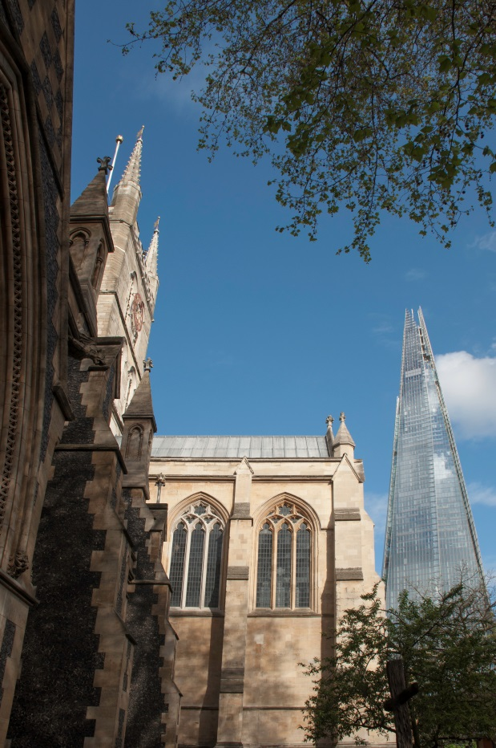



Forge Integration Workflow
Configure TRIRIGA for access to Forge Management tool
Register with Forge and create an application
Enter Forge app credentials in TRIRIGA
Define Forge Viewer storage
Export Revit model in NavisWorks format
Define and edit default view
Upload model file(s)
Request model translation
Upload Revit Model to TRIRIGA
Associate translated model with Building

Slide 3
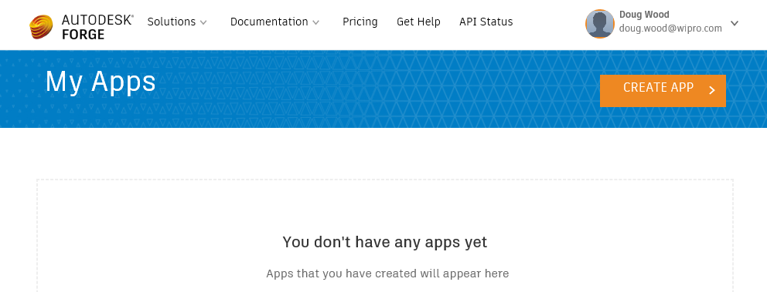
Autodesk Forge Portal
https://developer.autodesk.com/myapps
Use of the Forge viewer require a subscription to the Autodesk Forge Service. (90 day free trial available)
After registering, select “Create App” to create a Forge application and get a client ID and secret
TRIRIGA requires its own Forge application, not access to BIM360. It may be shared with other application such as Maximo which accept a Client ID and Secret.

Slide 4
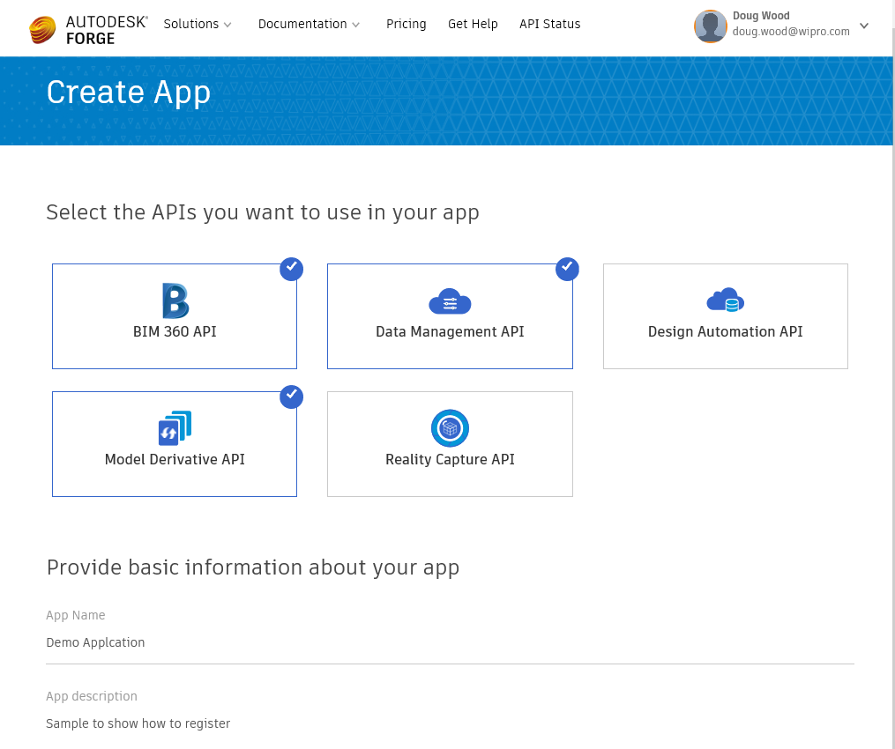
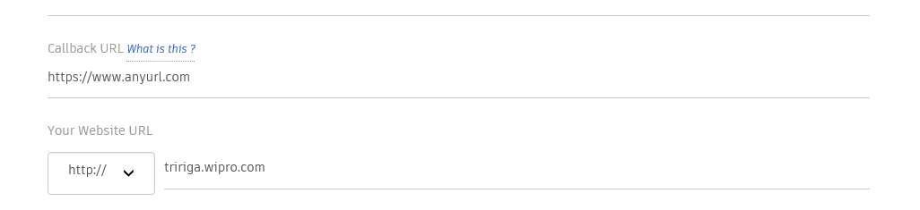
Create an Autodesk Forge Application
Optional
Not used enter anything in valid URL format

Slide 5
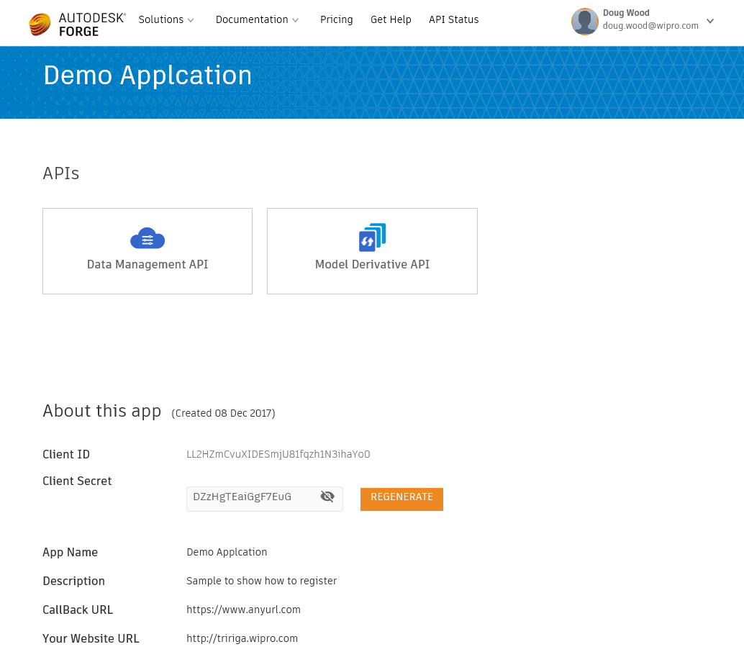
Create an Autodesk Forge Application
These values are provide to TRIRIGA

Slide 6
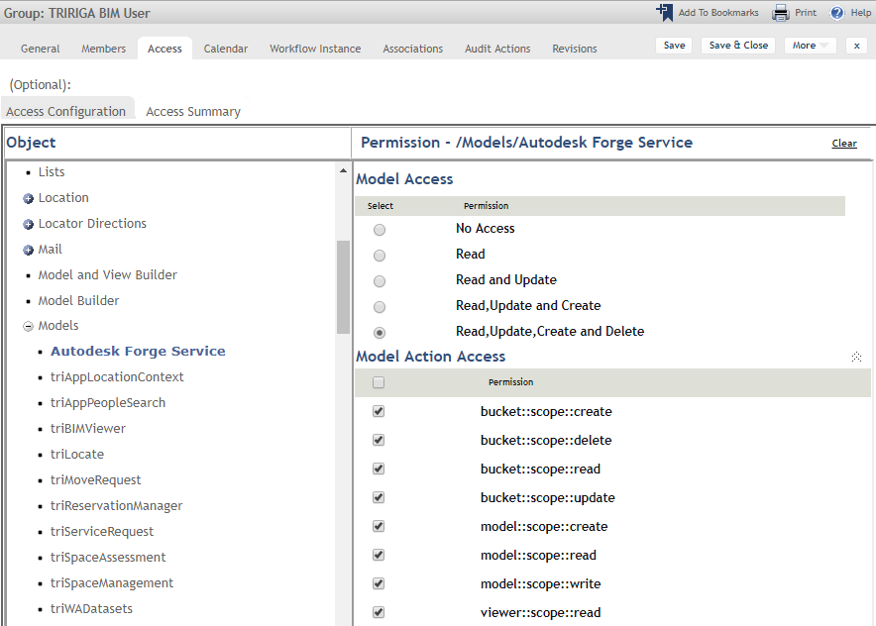
Forge Service Security
The security group TRIRIGA BIM User is pre-configured for full access to Forge tool
Access to individual Forge functions is controlled by the mode; “Autodesk Forge Service”. The permissions map directly to the Forge Oauth scopes defined here: https://developer.autodesk.com/en/docs/oauth/v2/overview/scopes/
Viewer::scope::read controls access to the viewer and model thumb nail. All user of the viewer must have this access
Security can be applied to the triBIMModelLink business object to control display of the model thumb nail and launch of the viewer. However, it only restricts display of the links to launch a model, not direct access to the model.

Slide 7
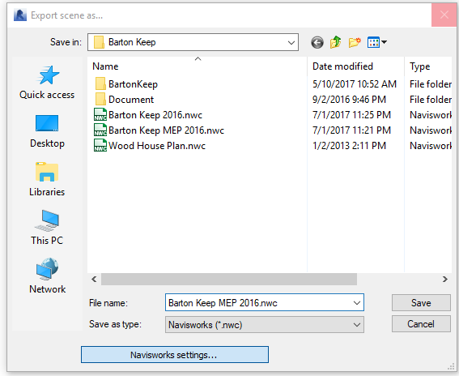
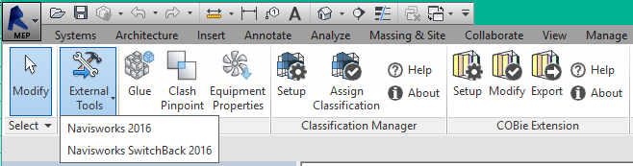
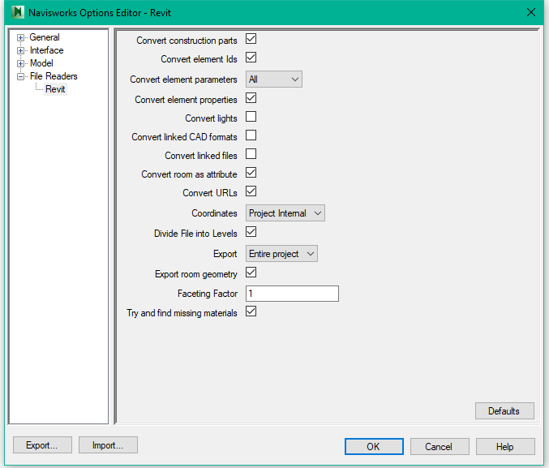
NavisWorks Export from Revit
NavisWorks Exporter
Display Export Settings
Select which properties to convert
Navisworks .NWD files can be used with the Forge viewer Using Navisworks files has several possible advantages:
Navisworks has a visual representation of Room and Space object which Revit does not
It is easy to customize the visual representation of a Navisworks file, such as color coding objects by type
It may be possible to import file formats not normally usable by the Forge viewer into Navisworks and display them
Due to the lack of Rooms in translated Revit models, the TRIRIGA linkage of spaces to the model only works with NavisWorks files.
The Revit file must be converted to NavisWorks format. A Revit model can be directly opened in NavisWorks, However, the Revit Exporter produces better models
Download the exporter here: https://www.autodesk.com/products/navisworks/3d-viewers
Include rooms

Slide 8
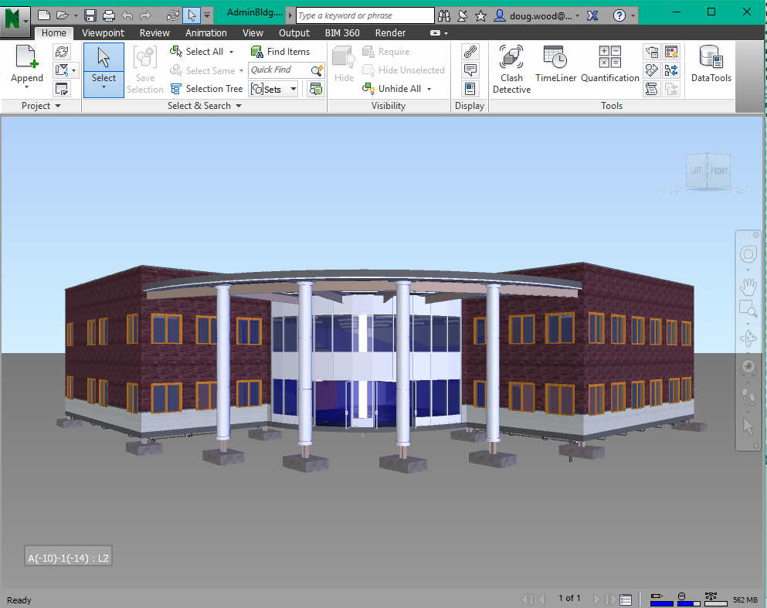
Configure Default View
The Forge translation process uses the default NavisWorks view – What is displayed when the model is first opened in NavisWorks
Multiple models can be merged in NavisWorks to provide a single model for the Forge viewer. Ex: Architectural, MEP, Structural.
The view can be configured however you wish including:
Position and orientation
Color coding elements
Hiding elements
The finished model should be saved as an .NWD or .NWC file

Slide 9
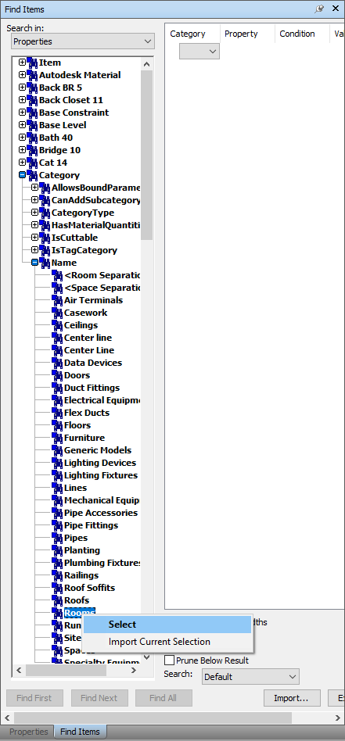
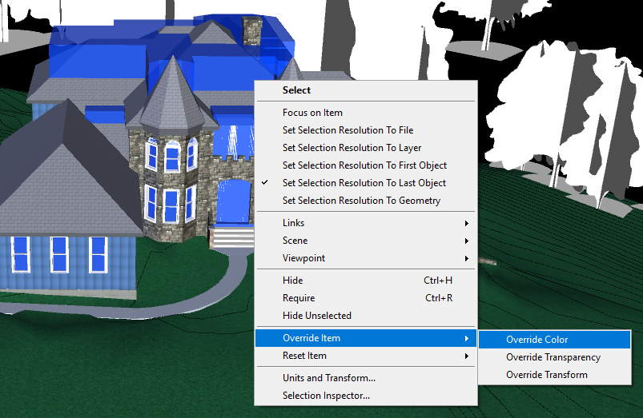
Make Rooms visible
Use the property browser to find and select all the room all the rooms
Display the property menu for the selection, Override Color and Transparency to create the desired visual effect. By default rooms are almost invisible
Select all the spaces, and hide the space.
Setup the view desired in the viewer. This may include hiding additional object or overriding color. It is fairly easy to use the category tree to color code elements based on category
Save the file as a .NWD file. The view visible when the file is save is what is imported in the Forge viewer
Upload and translate the .NWD file

Slide 10
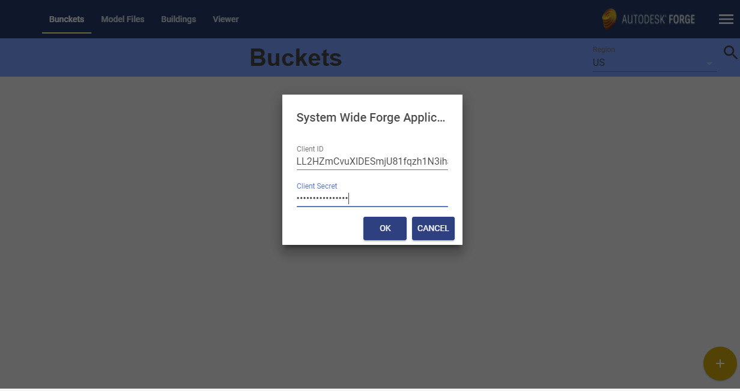
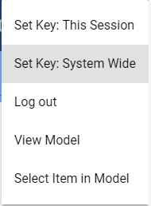
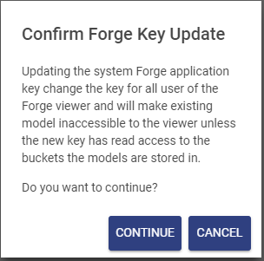
Adding Forge Credentials to TRIRIGA
Allows you to work with other Client IDs in a local session without effecting other users.
Enter Client ID and Secret from Create an Autodesk Forge Application
Select “System Wide” to store the Forge app credentials in the TRIRIGA database which provide viewer access to all authorized users
If this is the first time you have entered credentials, or you are only changing the secret, you can safely continue

Slide 11
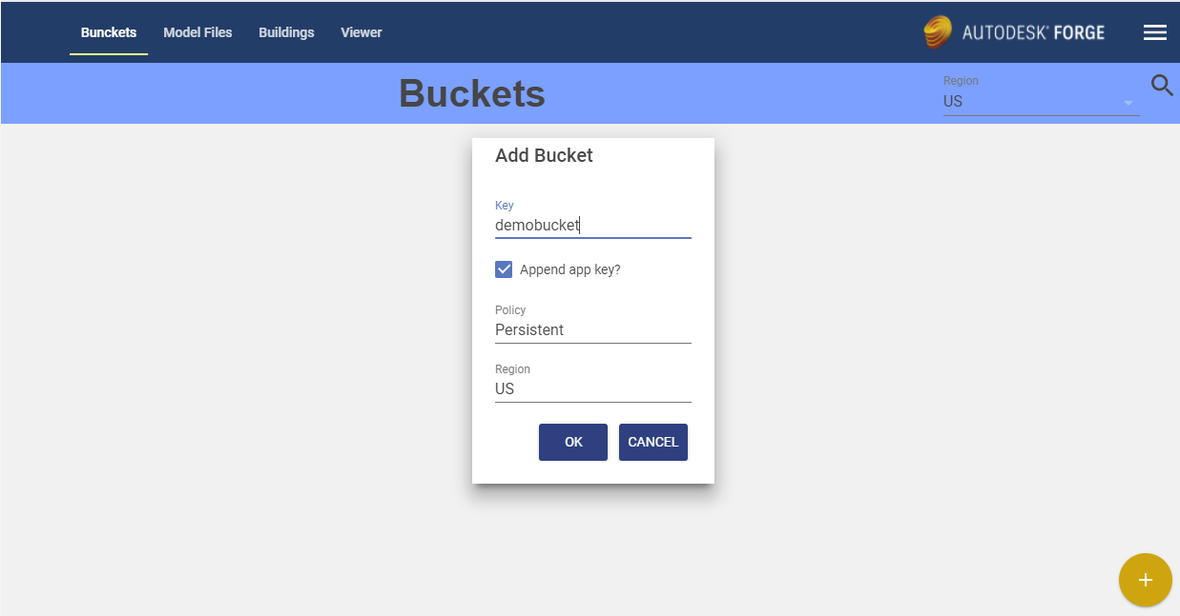
Create Forge “Buckets” to store your models
If a model has been translated to a viewable “bubble” and the model is subsequently deleted explicitly or because its tenure in a bucket has expired, the viewable file set is not deleted. However, Autodesk provides no way to list viewable file sets so the URN must be know. TRIRIGA only track the URN when it is associated with a building
The bucket key must be unique across all users of the Forge service. Autodesk recommends including your Client ID in your Bucket Key. If the Append Key option checked, the tool manages that automatically
Data retention policy:
Persistent: Until deleted
Temporary: 30 days
Transient: 24 hours
Geographic location where data is physically stored

Slide 12
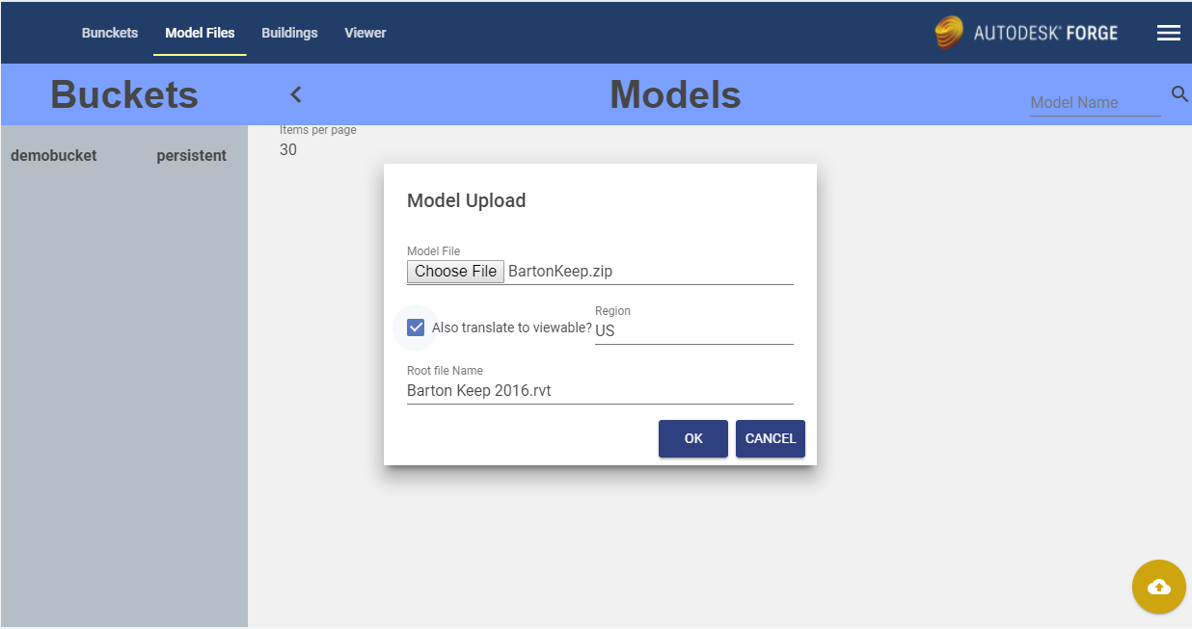
Uploading Models to the Forge Service
Multi-part models are uploaded as zip files.9
Automatically start translation when the upload completes.
Leave this blank for a single model file. For a zip file, specify the unqualified file name of the root model file

Slide 13
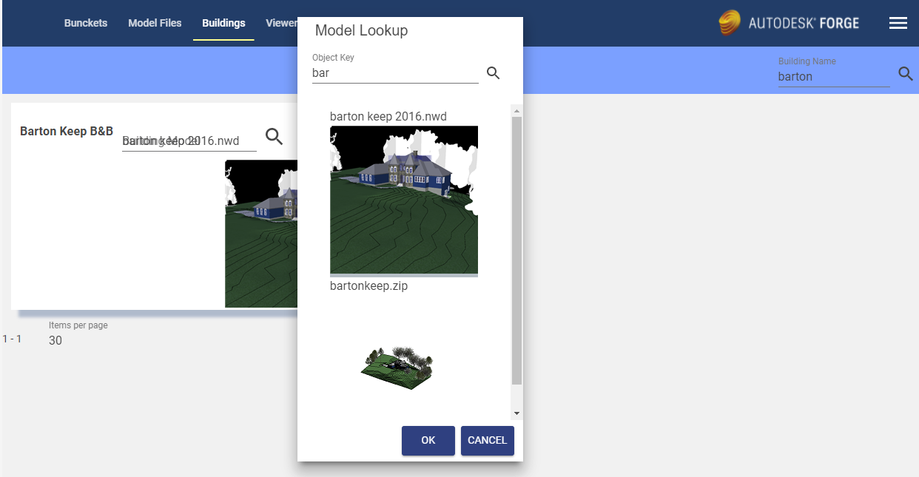
Link Forge Models to TRIRIGA Buildings
Search for TRIRIGA building by name and address
This list displays only the models. Shown on the models tab.

Slide 14
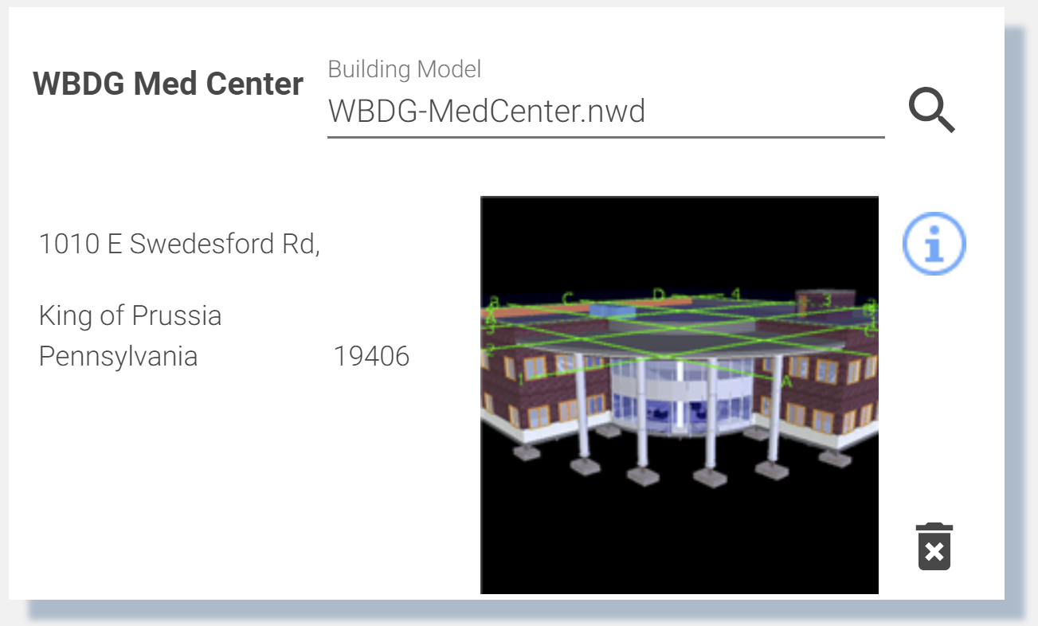
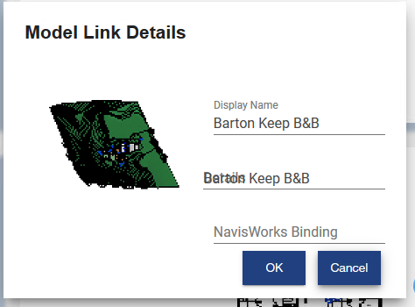
Building Link
Select model to link to building.
Additional model link information
Preview model in viewer.
Delete link to model.
Details: Additional descriptive information not processed by TRIRIGA.
Navisworks Binding: This is the name of the viewer property which is used to match a viewer element with a TRIRIGA record. If it is not set, it defaults to “GUID”. Some older Navisworks files require “Guid”. It can also be used to create custom binding for other model file types or if the TRIRIGA records were not created by the BIM Connector for Revit.

Slide 15
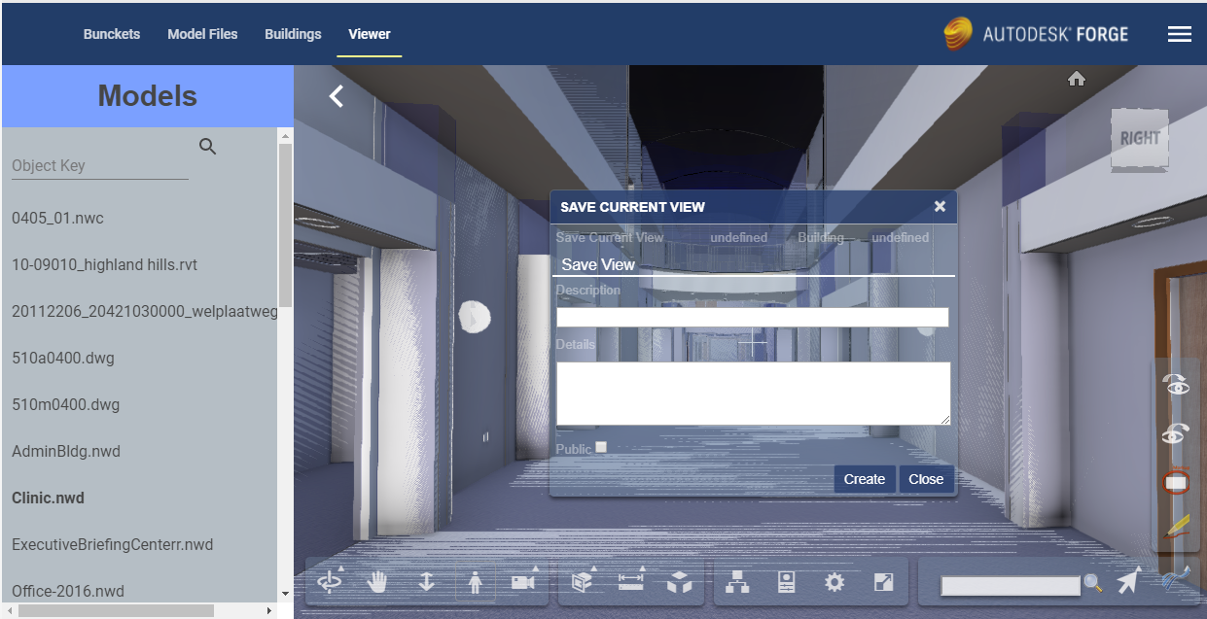
Defined views
Setup the view you want to save
Select and display the desired model
Select and display the desired model
Views are saved by user, but can be made public

Slide 16
BIM Connector for Revit

Slide 17
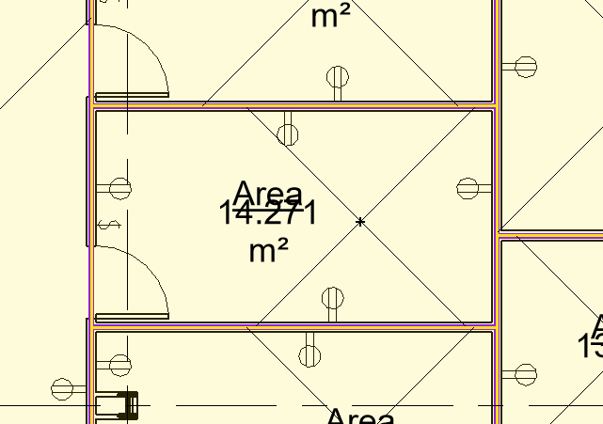
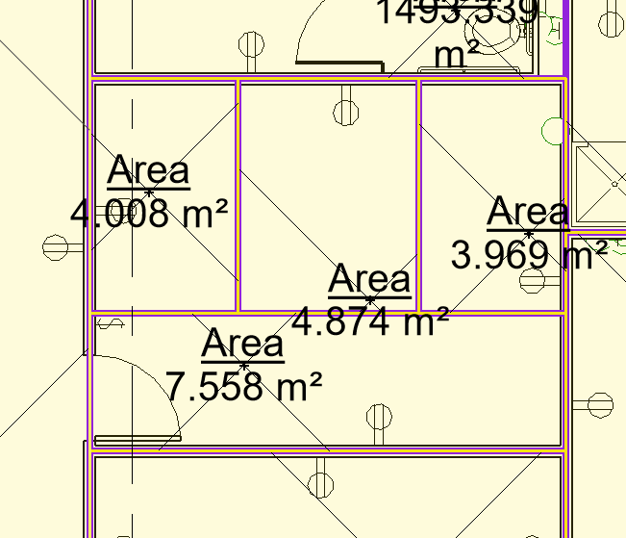
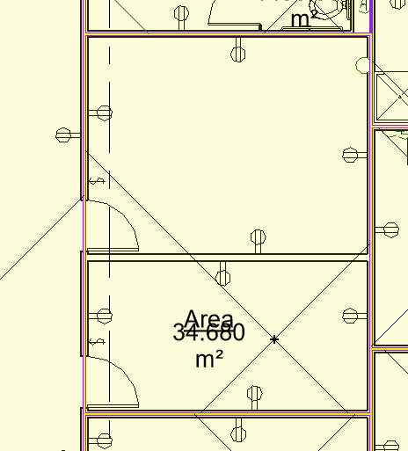
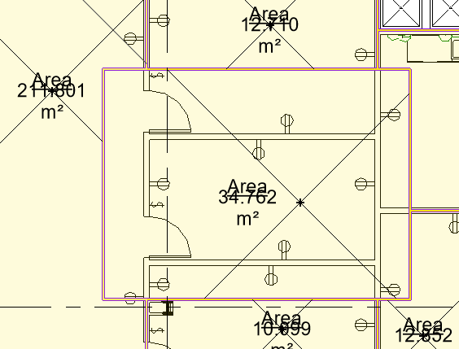
Revit Area and Area Plans
There are 4 cases of how an are can relate to a Room:
1) The area boundaries match the room boundaries
2) A room is comprised of exactly n areas
3) An area is encompassing exactly n rooms
4) Areas are arbitrary: area and room boundaries cross area boundaries
The BIM Connector supports case 1. Two areas can be associated with a room: a gross area, and a rentable area. For each area type, the area measurement provided by the area replaces the area measurement from the room.
For Floors, the total area for the gross are plan, if one exists is used for the Floor’s gross area, and if a rentable are plan exists and has been selected in the “Map Areas to Rooms” tool, the total area for the rentable area plan is used for the Floor’s gross measured area.

Slide 18
Best Practices
Integrate all Rooms you plan to integrate for all model files before you link spaces to rooms or directly integrate Revit Spaces with TRIRIGA.
For federated models, the IBM.ModelName value should be unique for each file in the set, and ideally be descriptive of the role the file is playing in the model. For the primary file, IBM.ModelName and IBM.BuildingName can be the same.
A gross area plan should be created for any level that will be integrated with Revit. Allow Revit to outline the exterior walls. If you subdivide the area plan into additional areas, insure that the entire level is filled with areas.
If area names are the same as room names, the auto-match can be used to link rooms to areas. If you expect to detach and re-integrate the model with any frequency, this will save work.
If space names are the same as room names, the auto-match can be used to link rooms to spaces. If you expect to detach and re-integrate the model with any frequency, this will save work.

